Slide 1
US DOE Roadmap Workshop
Marc LaFrance
8 December 2016
Buildings XIII Conference

Slide 2
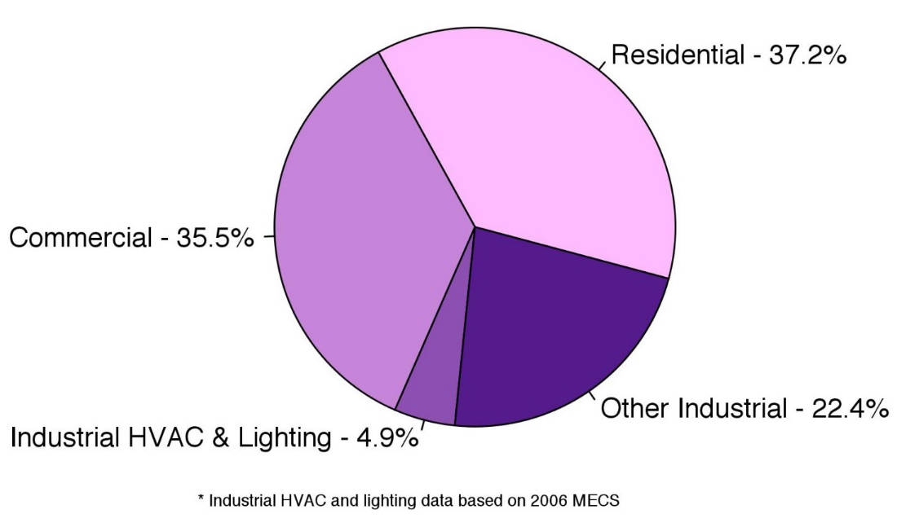
U.S. Energy and Electricity Consumption by Sector
Energy Use
Electricity Use
Residential
21 quads
Transportation
27 quads
Commercial
18 quads
Industrial
31 quads
Buildings Energy Use: 40% of U.S. total
Buildings Electricity Use: 76% of U.S. total
U.S. Building Energy Bill: $410 billion per year
Notes:
National Energy Use
Combined, our homes and buildings cost the country more than $410 billion a year to power, consume more than 40% of nation’s energy, 76% of the nation’s electricity, and contribute to 40% of the nation’s greenhouse gas emissions.
This represents a huge opportunity for further savings
Transition – Yet, even with increased interest in energy-saving technologies, many of America’s buildings are still extremely inefficient because of cost, infrastructure, and informational barriers.

Slide 3

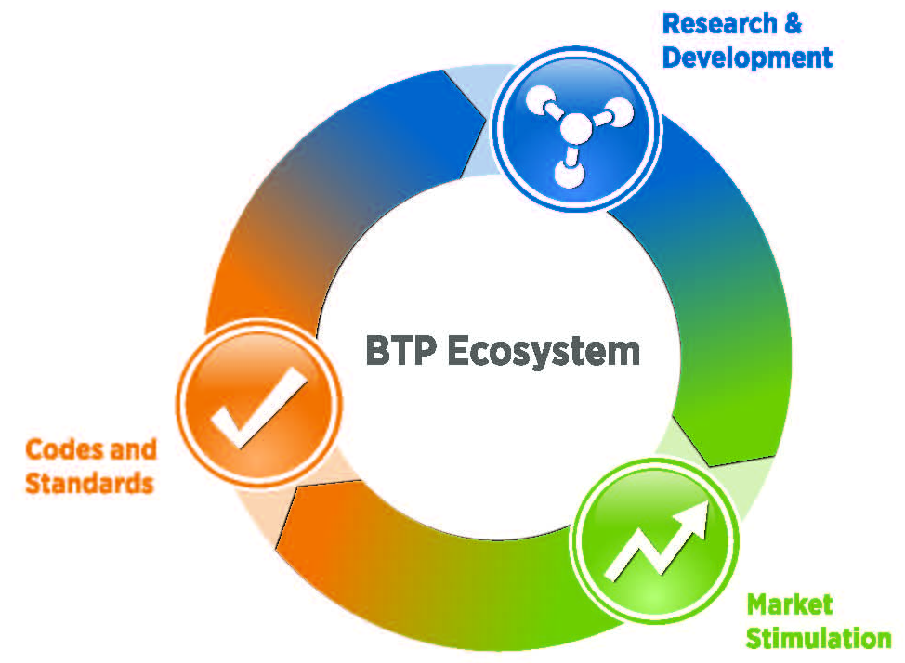


BTO’s Integrated Approach
Research & Development
Develop technology roadmaps
Prioritize opportunities
Solicit and select innovative technology solutions
Collaborate with researchers
Solve technical barriers and test innovations to prove effectiveness
Measure and validate energy savings
BTO Ecosystem
Market Stimulation
Identify barriers to speed and scale adoption
Collaborate with industry partners to improve market adoption
Increase usage of products & services
Work through policy, adoption, and financial barriers
Communicate the importance and value of energy efficiency
Provide technical assistance and training
Codes and Standards
Establish minimum energy use in a transparent public process
Protect consumer interests
Reduce market confusion
Enhance industry competitiveness & profitability
Expand portfolio of EE appliances & equipment
Raise the efficiency bar

Slide 4

BTO Releases 2016-2020 Multi-Year Program Plan
BTO Goal:
2030 goal: Reduce average energy use per square foot of U.S. buildings by 30% below 2010 levels
Long-term goal: reduce average EUI of U.S. buildings by 50%
National Goals:
By 2030, double energy productivity relative to 2010
Reduce greenhouse gas emissions 26%–28% below 2005 levels by 2025
http://energy.gov/eere/buildings/downloads/multi-year-program-plan
Notes:
We recently released our final (and first) Multi-Year Program Plan (MYPP) for 2016 – 2020.
This provides a broad overview of the energy use in the buildings sector, the opportunities for cost-effective energy savings, the barriers to their achievement, and BTO’s strategies and goals for achieving significant reductions in building energy use intensity.
The body of the plan describes each of BTO’s programs, providing a roadmap for their work over the next five years.
Each program section reviews the relevant market characteristics, including key market barriers, the program’s history, and a description of the remaining opportunities for energy savings, followed by a description of each of the program’s goals, the strategies used to achieve those goals, and a summary of specific program activities and key targets.
BTO 2030 Goal: Reduce average energy use intensity (EUI) per square foot, or energy use intensity (EUI) of all U.S. buildings by 30% below 2010 levels by 2030
BTO Long-term goal: Reduce average EUI by 50%
BTO is committed to annually tracking and reporting its progress toward the achievement of the goals described in the plan and to periodically updating the plan itself.
--------
Other Roadmaps:
Almost every one of our technology subprograms have their own detailed roadmaps detailing their strategies for driving down cost and increasing efficiency (SSL, HVAC, WH, Appliances, Low-GWP refrigerants, Windows and Building Envelope)
HIT Catalyst released their roadmap in 2015
The roadmaps help us determine which technologies we should focus on to enable to energy savings theoretically possible.
Upcoming roadmaps: Building Energy Modeling, Sensors and Controls
Our technology recommendations are built on direct input from industry stakeholders and research on the key challenges that must be addressed to achieve the specified savings targets.
The recommended R&D initiatives collectively support innovations that will accelerate development of both near-term technological improvements and next-generation (i.e., transformational) technologies.
You’ll hear more on the new program goals and activities later on in the plenary and also during the Program sessions this afternoon.

Slide 5

IEA Building Envelope Technology Roadmap - 2013
Source IEA:
Envelope Roadmap http://www.iea.org/publications/freepublications/publication/TechnologyRoadmapEnergyEfficientBuildingEnvelopes.pdf

Slide 6
Large Opportunity for Insulation

Slide 7
Many Old Inefficient Windows in Service

Slide 8
Assessment of High Priority Items – US Perspectives

Slide 9
Cost and Performance Objectives - Envelope

Slide 10
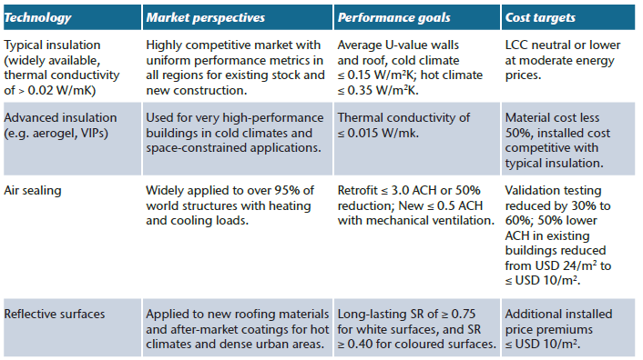
Cost and Performance Objectives - Windows

Slide 11
US DOE Envelope and Window Roadmap - 2014
US DOE Roadmap
http://energy.gov/sites/prod/files/2014/02/f8/BTO_windows_and_envelope_report_3.pdf

Slide 12
Envelope and Window Roadmap – 2014 (envelope priorities)
Technology | 2025 Installed Cost Premium Target |  |  | 2025 Performance Target
Highest Priority R&D Areas
Building envelope insulation |  | ≤ $0.25/ft² |  | ≥ R-12/inch thermal insulation material for retrofitting walls Meets durability requirements Minimizes occupant disturbance
Air-sealing technologies |  | ≤ $0.5/ft² finished floor |  | Residential < 1 ACH50 Commercial: < 0.25 CFM75/ft² Concurrently regulates heat, air, and moisture
High Priority R&D Area
Highly insulating roofs (commercial) |  |  | ≤ $1/ft² over standard roof costs | Energy use reduction equivalent to doubling current ASHRAE R-values

Slide 13
Envelope and Window Roadmap – 2014 (window priorities)
Technology | 2025 Installed Cost Premium Target | 2025 Performance Target
Highest Priority R&D Area
R-10 Windows | Residential: ≤ $6/ft² Commercial: ≤ $3/ft² over typical 2010 windows | Residential: R-10, V_{T} > 0.6 Commercial: R-7, V_{T} > 0.4 Comparable weight and thickness to currently installed base
High Priority R&D Areas
Dynamic Windows | Windows: ≤ $8/ft² Window Films: ≤ $2/ft² over a standard IGU | ΔSHGC > 0.4 V_{T} bleached state > 0.6 (residential) and > 0.4 (commercial)
Visible light redirection (commercial) | ≤ $5/ft² over standard window or shade including lighting and controls costs | 50% reduction in lighting energy use over a 50-ft floor plate

Slide 14
2010 – Energy Consumption by Envelope Area
Source: US DOE Roadmap

Slide 15
Savings Potential to 2030 – Staged by Cost Effectiveness
Source: US DOE Roadmap; R – residential, C - commercial

Slide 16
Envelope Highest Priority Action Plan – DOE Roadmap

Slide 17
Window Highest Priority Action Plan – DOE Roadmap

Slide 18

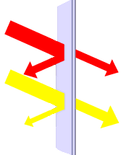



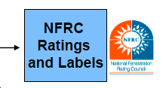


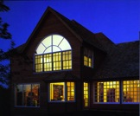
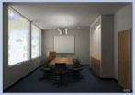
Current Window Activities and Perspectives
Design /Simulation Tools
IGDB
(Specular Glass Data Source)
Optics
THERM
(Window
Angular
SHGC/U/VT
(Window
Glass)
Frame)
(Rating/Lableling)
CGDB
(Complex Glazing Data Base)
WINDOW
+
Shading
Systems
(Whole Window)
EnergyStar
Ratings
Radiance
Lighting /Daylighting
COMFEN
RESFEN
(Whole Building
Commercial)
(Whole Building
Residential)

Slide 19
Current windows activity
Financial Awards
  PPG: Fabricate-on-demand Vacuum Insulated Glazing
  WCMA: Attachments Energy Rating Council (AERC)
  Arconic (Alcoa): Novel Thermal Break with Simplified Manufacturing for R-7 Commercial Windows
  LBNL and Pella: Highly Insulating Residential Windows Using Smart Automated Shading
Annual Operating Plan Projects
  LBNL: window suite of software tools development and maintenance
  NREL: durability testing
International Collaboration with India (CBERD) and China (CERC); small level of effort on window activity

Slide 20
Next Generation of Windows
Highly insulated and dynamic solar control
  Prototype on permanent display in DOE Forrestal Building Lobby
  Niche products commercialized over five years ago
Value to low energy buildings
  Improved thermal and visual comfort, reduced noise, smaller HVAC, reduced peak loads
  Residential: eliminate branch duct work and allow for more window area, may enable easier duct work inside conditioned space
  Commercial: perimeter zone conditioning eliminated, lower utility rates linked to peak demand
How to build consumer demand, industry feedback?
  R&D perspectives
  Voluntary programs to grow market demand
  Improve value proposition on conventional window replacements, etc

Slide 21
Key Challenges and Opportunities for Windows
Window replacement not usually cost effective based on energy benefits unless replacing window anyway
  reduce installed cost (new and retrofit)
Ensuring quality, consistent installation, and transparency on what customers buy
  replacement window vs new window
Integrated wall/window upgrade as a system should reduce cost and add “market value” to homes
  Is it possible to get early window replacement based on home value improvements?
Value proposition to consumers can be increased by reducing cost and fully assessing benefits
  all energy impacts: infiltration, comfort, thermostat settings; and non-energy benefits: reduced noise, aesthetics, resale and market value, etc

Slide 22
Window Replacement Priorities and Retrofit Options
First choice is to install a R5 window when possible, especially in Zero Energy Ready Homes
Second choice, install ENERGY STAR windows properly with low interface infiltration; permanent solution that will not be removed during housing turnover
Retrofit option to reduce thermal loads: low-e storm windows and cellular shades are probably best performance, but ratings will drive innovation
Retrofit option to reduce solar loads: exterior shading probably best performance, has been demonstrated to eliminate cooling equipment in moderate climates such as EU, window film proven retrofit option
Dynamic shading is a key gateway to fully dynamic windows offering higher passive heating benefits and reduced solar gain

Slide 23
Deep Energy Renovation (DER)
Global Buildings Performance Network defined (DER) as 30% to 50% savings of all building loads in US and 75% of HVAC and water heating loads or more in the EU
Core DOE MYP residential goal is to reduce HVAC and water heating loads by 50%
Proposed approach based on key modules
  Module 1 – Integrated wall/window upgrade with air sealing, pursue 700K home siding upgrades per year; market based on home value and use EE financing
  Module 2 – Comprehensive attic upgrade including air sealing, duct sealing, insulation and ventilation; based on EE cost effectiveness, pursue existing attic insulation jobs and market upsell when re-roofing
  Module 3 – Smart HVAC, smaller capacity and higher performance when modules 1 & 2 completed first, complete basement/rim joist insulation and consider water heating options

Slide 24
Working with DOE
Participate in roadmap and planning events
Contribute to discussion and priority setting
Lead pre-competitive market impact and assessment analysis to grow window replacement and value added product adoption markets
Feedback on DOE activities and portfolio?

Slide 25
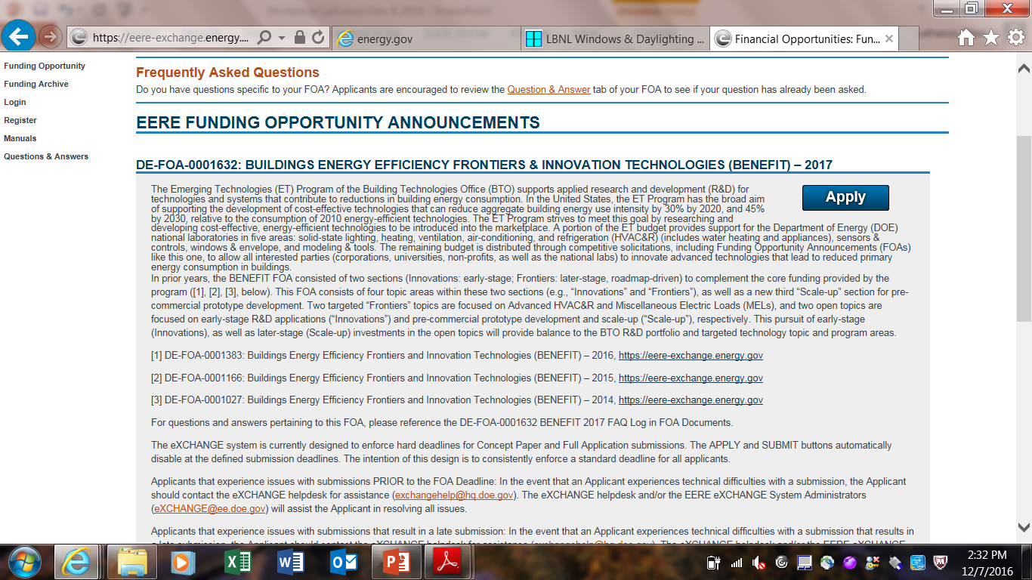
FY 17 BENEFIT Innovative and Scale Up Topics (Competitive FOA)
https://eere-exchange.energy.gov

Slide 26
Contact Information – Residential and Emerging Technologies Teams
P Marc LaFrance, CEM
Advanced Technology and Energy Policy Manager
US Department of Energy
1000 Independence Ave, SW
Washington, DC 20585-0121 marc.lafrance@ee.doe.gov
202-586-4972
Cell 240-474-2177

