Slide 1
Generative Topographic Mapping by Deterministic Annealing
Jong Youl Choi, Judy Qiu, Marlon Pierce, and Geoffrey Fox
School of Informatics and Computing
Pervasive Technology Institute
Indiana University
SALSA project
http://salsahpc.indiana.edu

Slide 2
Dimension Reduction
High Dimensional Data
Low Dimensional Data
PubChem Data
(166 dimensions)
Simplication, feature selection/extraction, visualization, etc.
Preserve the original data’s information as much as possible in lower dimension

Slide 3
Generative Topographic Mapping
K latent points
N data points
An algorithm for dimension reduction
Based on the Latent Variable Model (LVM)
Find an optimal user-defined K latent variables in L-dim.
Non-linear mappings
Find K centers for N data
K-clustering problem, known as NP-hard
Use Expectation-Maximization (EM) method

Slide 4
Generative Topographic Mapping
K latent points
N data points
GTM with EM method (Maximize Log-Likelihood)
Define K latent variables (z_{k}) and a non-linear mapping function f with random
Map K latent points to the data space by using f
Measure proximity based on Gaussian noise model
Update f to maximize log-likelihood
Find a configuration of data points in the latent space
Notes:
Bayesian

Slide 5
Advantages of GTM
Computational complexity is O(KN), where
N is the number of data points
K is the number of latent variables or clusters. K << N
Efficient, compared with MDS which is O(N²)
Produce more separable map (right) than PCA (left)
PCA
GTM

Slide 6
Challenges
GTM’s EM find only local optimal solution
Need a method to find global optimal solution
Applying Deterministic Annealing (DA) algorithm
Find better convergence strategy
Control parameters in a dynamic way
Proposing “adaptive” schedule

Slide 7
Challenges
GTM’s EM find only local optimal solution
Need a method to find global optimal solution
Applying Deterministic Annealing (DA) algorithm
Find better convergence strategy
Control parameters in a dynamic way
Proposing “adaptive” schedule

Slide 8
Deterministic Annealing (DA)
An heuristic to find a global solution
The principle of maximum entropy : choose a solution when entropy is maximum, the answer will be the most unbiased and non-committal
Similar to Simulated Annealing (SA) which is based on random walk model
But, DA is deterministic with no use of randomness
New paradigm
Analogy in thermodynamics
Find solutions as lowering temperature T
New objective function, free energy F = D − TH
Minimize free energy F by lowering T → 1
Notes:
F : Helmholtz free energy
D : expected distortion
H : Shannon entropy

Slide 9
Free Energy for GTM
Free Energy
D : expected distortion
H : Shannon entropy
T : computational temperature
Z_{n} : partitioning function
Partitioning Function for GTM

Slide 10
GTM with Deterministic Annealing
EM-GTM
DA-GTM
Optimization
Maximize log-likelihood L
Minimize free energy F
Objective Function
When T = 1, L = -F.
Pros & Cons
Very sensitive
Trapped in local optima
Faster
Large deviation
Less sensitive to an initial condition
Find global optimum
Require more computational time
Small deviation

Slide 11
Challenges
GTM’s EM find only local optimal solution
Need a method to find global optimal solution
Applying Deterministic Annealing (DA) algorithm
Find better convergence strategy
Control parameters in a dynamic way
Proposing “adaptive” schedule

Slide 12
Adaptive Cooling Schedule
Typical cooling schedule
Fixed
Exponential
Linear
Adaptive cooling schedule
Dynamic
Adjust automatically
Move to the next critical temperature as fast as possible
Temperature
Iteration
Iteration
Temperature
Iteration

Slide 13
Phase Transition
DA’s discrete behavior
In some range of temperatures, the solution is settled
At a specific temperature, start to explode, which is known as critical temperature T_{c}
Critical temperature T_{c}
Free energy F is drastically changing at T_{c}
Second derivative test : Hessian matrix loose its positive definiteness at T_{c}
det ( H ) = 0 at T_{c} , where

Slide 14
Demonstration
25 latent points
1K data points

Slide 15
1st Critical Temperature
At T > T_{c} , only one effective latent point exists
All latent points are settled in a center (settled)
At T = T_{c}, latent points start to explode
At T = T_{c}, det( H ) = 0
H is a KD-by-KD matrix
T_{c} is proportional to the maximum eigenvalue of covariance matrix.

Slide 16
j^{th} Critical Temperature (j > 1)
Hessian matrix is no more symmetric
Determinants of a block matrix
Efficient way
Only consider det(H_{kk}) = 0 for k = 1 … K
Among K candidates of T_{c}, choose the best one
Easily parallelizable

Slide 17
DA-GTM with Adaptive Cooling

Slide 18
DA-GTM Result
496
466
427
511
(α = 0.95)
(α = 0.99)
(1st T_{c} = 4.64)

Slide 19
Conclusion
GTM with Deterministic Annealing (DA-GTM)
Overcome short-comes of traditional EM method
Find an global optimal solution
Phase-transitions in DA-GTM
Closed equation for 1st critical temperature
Numeric approximation for j^{th} critical temperature
Adaptive cooling schedule
New convergence approach
Dynamically determine next convergence point

Slide 20
Thank you
Question?
Email me at jychoi@cs.indiana.edu

Slide 21
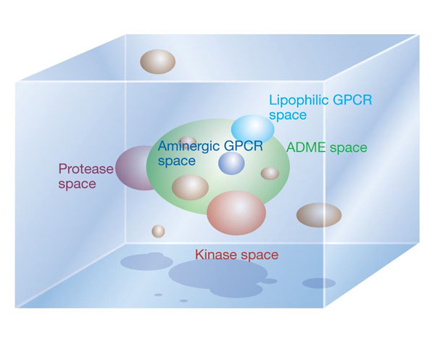
Navigating Chemical Space
Christopher Lipinski, “Navigating chemical space for biology and medicine”, Nature, 2004

Slide 22
Comparison of DA Clustering
DA Clustering
DA-GTM
Distortion
Related Algorithm
K-means
Gaussian mixture
Distortion
DA Clustering
DA-GTM
Distance

