Slide 1
Browsing Large Scale Cheminformatics Data with Dimension Reduction
Jong Youl Choi, Seung-Hee Bae, Judy Qiu, Geoffrey Fox
School of Informatics and Computing
Pervasive Technology Institute
Indiana University
Bin Chen, David Wild
School of Informatics and Computing
Indiana University
SALSA project
http://salsahpc.indiana.edu

Slide 2
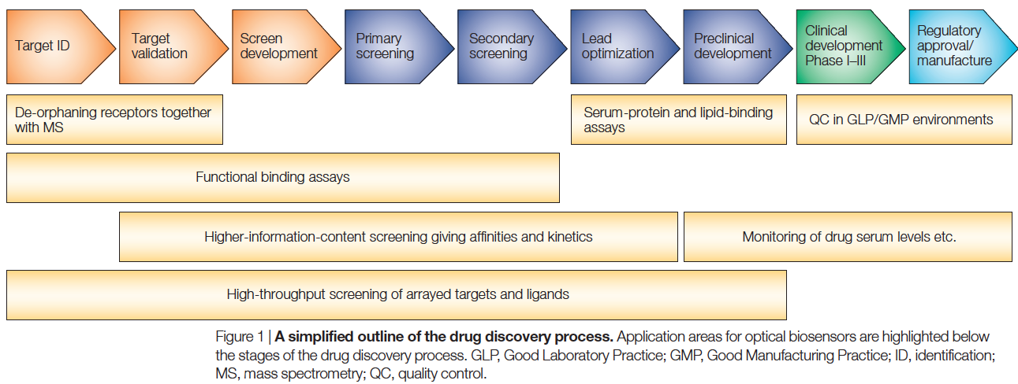
Drug Discovery
Nature Reviews Drug Discovery 1, 515–528 (1 July 2002)
A pipeline process with various stages
Many screening processes to filter out large number of chemical compounds
Empirical science

Slide 3
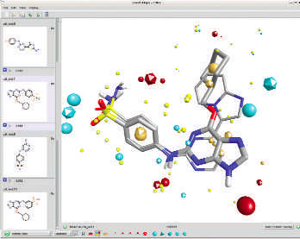
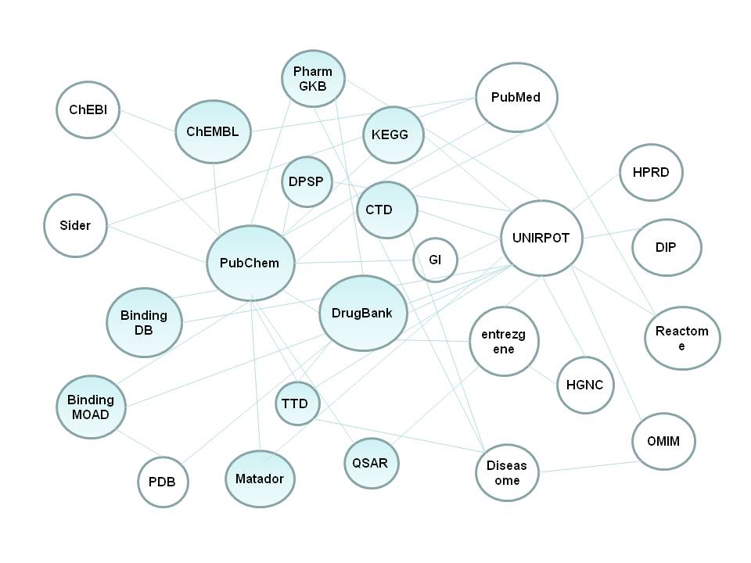
Data Mining for Drug Discovery
Modern drug discovery
Not an empirical science anymore
Data intensive science
Use of in silico screening methods
Numerous open databases
NIH founded PubChem
DrugBank, Comparative Toxicogenomics Database (CTD), …
(Cresset’s FieldAlign, Nature, 2007)
(Chem2Bio2RDF)
Notes:
Drug discovery process nowadays consume bench scientists

Slide 4
Motivation
To browse large and high-dimensional data
Data visualization by dimension reduction
High-performance dimension reduction algorithms
To utilize many open (value-added) data
Combine data from different sources in one place
A uniform interface
A light-weight easy-to-use visualization tool
A desktop client with an user-friendly UI
Easy to use high-performance computing resources
Notes:
To help efficient drug discovery, we have developed a system with the following three motivations

Slide 5
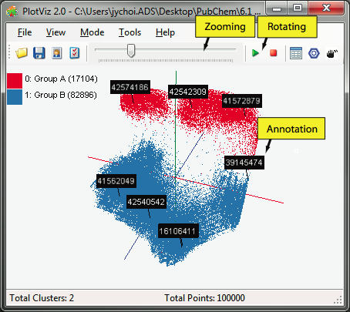
PubChemBrowse System
PubChemBrowse
3-D Map File
Light-weight client
SPARQL query
Meta data
DrugBank
CTD
QSAR
Visualization Algorithms
PubChem
Chem2Bio2RDF
Parallel dimension reduction algorithms
Aggregated public databases

Slide 6
Visualization by Dimension Reduction
High Dimensional Data
Low Dimensional Data
PubChem Data
(166 dimensions)
Simplify data
Preserve the original data’s information as much as possible in lower dimension
Explore enormous data in 3D

Slide 7
Visualization Algorithms
Compute- and memory-intensive algorithms
High-performance is not for free
Commodity hardware is not capable of processing large data
In-house high-performance visualization algorithms
Parallel GTM (Generative Topographic Mapping)
Parallel MDS (Multi-dimensional Scaling)
Further performance improvement by interpolation extensions to GTM and MDS

Slide 8
GTM vs. MDS
GTM
MDS (SMACOF)
Purpose
Non-linear dimension reduction
Find an optimal configuration in a lower-dimension
Iterative optimization method
Input
Vector-based data
Non-vector (Pairwise similarity matrix)
Objective Function
Maximize Log-Likelihood
Minimize STRESS or SSTRESS
Complexity
O(KN) (K << N)
O(N²)
Optimization
Method
EM
Iterative Majorization (EM-like)

Slide 9
Parallel GTM
Finding K clusters for N data points
Relationship is a bipartite graph (bi-graph)
Represented by K-by-N matrix (K << N)
Decomposition for P-by-Q compute grid
Reduce memory requirement by 1/PQ
Example:
A 8-byte double precision matrix for N=100K and K=8K requires 6.4GB
A
A
B
C
1
B
1
2
C
2
K latent points
N data points

Slide 10
Parallel MDS
Example:
A 8-byte double precision matrix for N=100K requires 80GB
Decomposition for P-by-Q compute grid
Reduce memory requirement by 1/PQ
A
B
C
A
B
C

Slide 11
Interpolation extension to GTM/MDS
Full data processing by GTM or MDS is computing- and memory-intensive
Two step procedure
Training : training by M samples out of N data
Interpolation : remaining (N-M) out-of-samples are approximated without training
M In-sample
Training
Trained data
N-M
Out-of-sample
Interpolated
GTM/MDS map
Interpolation
Total N data
Notes:
Another approach to improve GTM performance is to develop an interpolation algorithm for GTM.
As we consider the GTM as a machine learning algorithm, the training process of GTM is to learn K centers based on N data points.

Slide 12
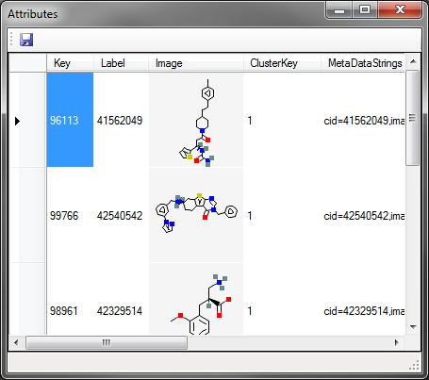
PubChemBrowse
Light-weight desktop client
Interactive user interface
Display 3D embedding and meta data

Slide 13
Chem2Bio2RDF
Value-added database of databases
Aggregate over 20 public databases (PubChem, CTD, DrugBank, … )
Stored in RDF (Resource Description Framework)
Support SPARQL query language
SPARQL query
A W3C standard query language for RDF
PREFIX foaf: <http://xmlns.com/foaf/0.1/>
SELECT ?name ?email
WHERE {
?person a foaf:Person.
?person foaf:name ?name.
?person foaf:mbox ?email.
}

Slide 14
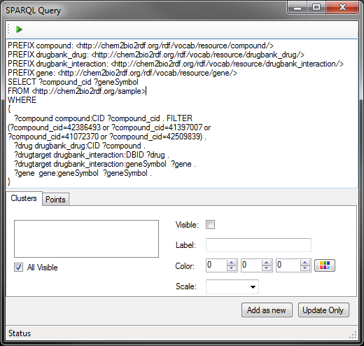
Query Interface

Slide 15
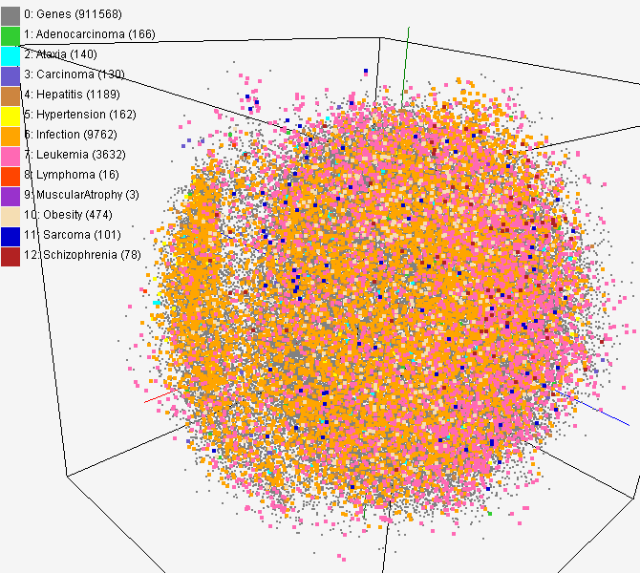
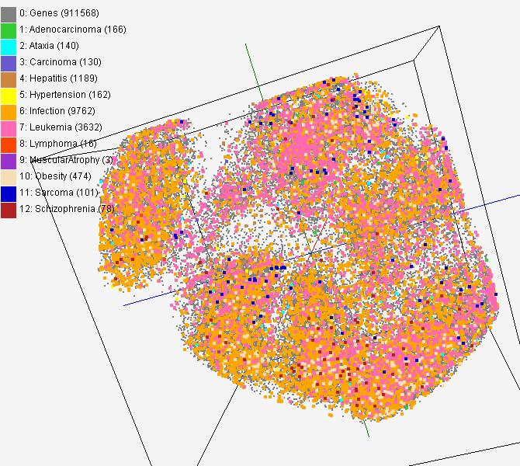
CTD data for gene-disease
PubChem data with CTD visualization by using MDS (left) and GTM (right)
About 930,000 chemical compounds are visualized as a point in 3D space, annotated by the related genes in Comparative Toxicogenomics Database (CTD)

Slide 16
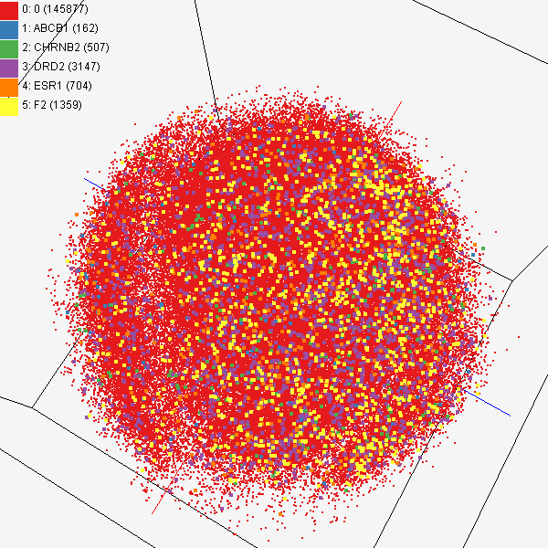
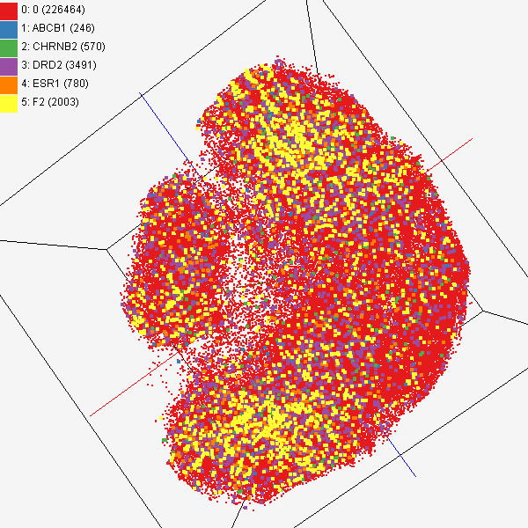
Chem2Bio2RDF
Chemical compounds shown in literatures, visualized by MDS (left) and GTM (right)
Visualized 234,000 chemical compounds which may be related with a set of 5 genes of interest (ABCB1, CHRNB2, DRD2, ESR1, and F2) based on the dataset collected from major journal literatures which is also stored in Chem2Bio2RDF system.

Slide 17
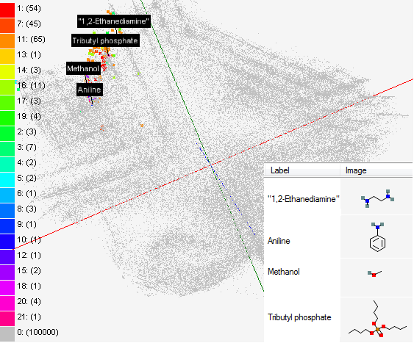
Solvent screening
Visualizing 215 solvents
215 solvents (colored and labeled) are embedded with 100,000 chemical compounds (colored in grey) in PubChem database

Slide 18
Conclusion
Modern drug discovery
Data intensive process
High-throughput in silico screening methods
PubChemBrowse
A light-weight desktop client
Parallel high-performance visualization algorithms
Access multiple databases via Chem2Bio2RDF by using an uniform interface, SPARQL query

Slide 19
Thank you
Question?
Email me at jychoi@cs.indiana.edu

